Slide 1

Parallel Programming in C with MPI and OpenMP
Michael J. Quinn

Slide 2
Chapter 12
Solving Linear Systems

Slide 3
Outline
Terminology
Back substitution
Gaussian elimination
Jacobi method
Conjugate gradient method

Slide 4
Terminology
System of linear equations
  Solve Ax = b for x
Special matrices
  Symmetrically banded
  Upper triangular
  Lower triangular
  Diagonally dominant
  Symmetric

Slide 5
Symmetrically Banded
4
2
-1
0
0
0
3
-4
5
6
0
0
1
6
3
2
4
0
0
2
-2
0
9
2
0
0
7
3
8
7
Semibandwidth 2
0
0
0
4
0
2

Slide 6
Upper Triangular
4
2
-1
5
9
2
0
-4
5
6
0
-4
0
0
3
2
4
6
0
0
0
0
9
2
0
0
0
0
8
7
0
0
0
0
0
2

Slide 7
Lower Triangular
4
0
0
0
0
0
0
0
0
0
0
0
5
4
3
0
0
0
2
6
2
3
0
0
8
-2
0
1
8
0
-3
5
7
9
5
2

Slide 8
Diagonally Dominant
19
0
2
2
0
6
0
-15
2
0
-3
0
5
4
22
-1
0
4
2
3
2
13
0
-5
5
-2
0
1
16
0
-3
5
5
3
5
-32

Slide 9
Symmetric
3
0
2
2
0
6
0
7
4
3
-3
5
5
4
0
-1
0
4
2
3
-1
9
0
-5
0
-3
0
0
5
5
6
5
4
-5
5
-3

Slide 10
Back Substitution
Used to solve upper triangular system
Tx = b for x
Methodology: one element of x can be immediately computed
Use this value to simplify system, revealing another element that can be immediately computed
Repeat

Slide 11
Back Substitution
1x₀
+1x₁
–1x₂
+4x₃
=
8
– 2x₁
–3x₂
+1x₃
=
5
2x₂
– 3x₃
=
0
2x₃
=
4

Slide 12
Back Substitution
1x₀
+1x₁
–1x₂
+4x₃
=
8
– 2x₁
–3x₂
+1x₃
=
5
2x₂
– 3x₃
=
0
2x₃
=
4
x₃ = 2

Slide 13
Back Substitution
1x₀
+1x₁
–1x₂
=
0
– 2x₁
–3x₂
=
3
2x₂
=
6
2x₃
=
4

Slide 14
Back Substitution
1x₀
+1x₁
–1x₂
=
0
– 2x₁
–3x₂
=
3
2x₂
=
6
2x₃
=
4
x₂ = 3

Slide 15
Back Substitution
1x₀
+1x₁
=
3
– 2x₁
=
12
2x₂
=
6
2x₃
=
4

Slide 16
Back Substitution
1x₀
+1x₁
=
3
– 2x₁
=
12
2x₂
=
6
2x₃
=
4
x₁ = –6

Slide 17
Back Substitution
1x₀
=
9
– 2x₁
=
12
2x₂
=
6
2x₃
=
4

Slide 18
Back Substitution
1x₀
=
9
– 2x₁
=
12
2x₂
=
6
2x₃
=
4
x₀ = 9

Slide 19
Pseudocode
for i ← n − 1 down to 1 do
x [ i ] ← b [ i ] / a [ i, i ]
for j ← 0 to i − 1 do
b [ j ] ← b [ j ] − x [ i ] × a [ j, i ]
endfor
endfor
Time complexity: Θ(n²)

Slide 20
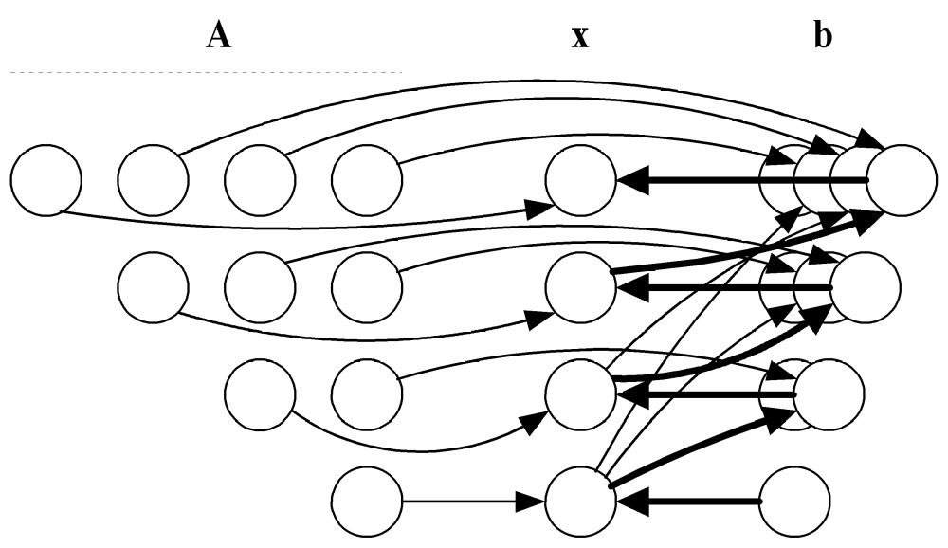
Data Dependence Diagram
We cannot execute the outer loop in parallel.
We can execute the inner loop in parallel.

Slide 21
Row-oriented Algorithm
Associate primitive task with each row of A and corresponding elements of x and b
During iteration i task associated with row j computes new value of b_{j}
Task i must compute x_{i} and broadcast its value
Agglomerate using rowwise interleaved striped decomposition

Slide 22
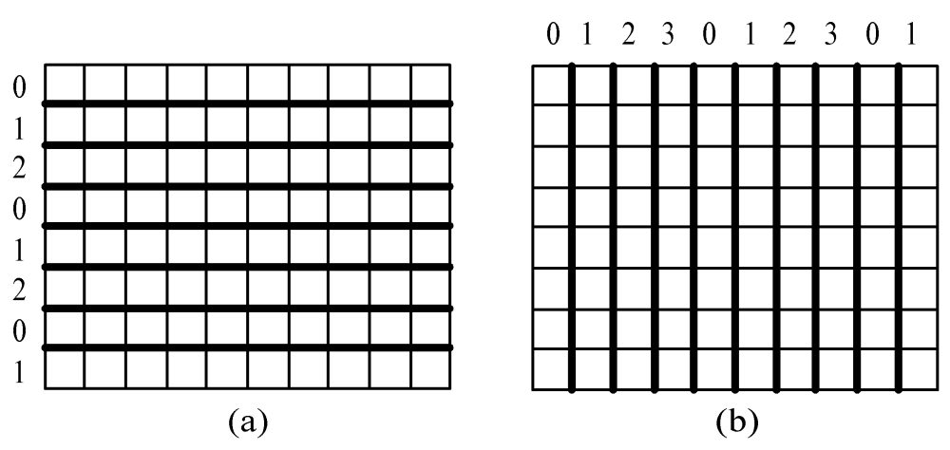
Interleaved Decompositions
Rowwise interleaved
striped decomposition
Columnwise interleaved
striped decomposition

Slide 23
Complexity Analysis
Each process performs about n / (2p) iterations of loop j in all
A total of n -1 iterations in all
Computational complexity: Θ(n²/p)
One broadcast per iteration
Communication complexity: Θ(n log p)

Slide 24
Column-oriented Algorithm
Associate one primitive task per column of A and associated element of x
Last task starts with vector b
During iteration i task i computes x_{i}, updates b, and sends b to task i -1
In other words, no computational concurrency
Agglomerate tasks in interleaved fashion

Slide 25
Complexity Analysis
Since b always updated by a single process, computational complexity same as sequential algorithm: Θ(n²)
Since elements of b passed from one process to another each iteration, communication complexity is Θ(n²)

Slide 26
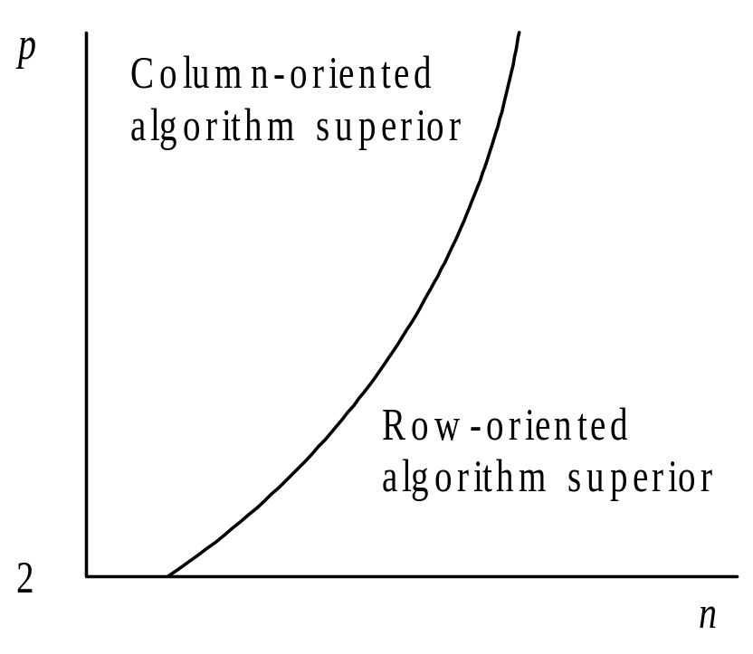
Comparison
Message-
passing time
dominates
Computation
time dominates

Slide 27
Gaussian Elimination
Used to solve Ax = b when A is dense
Reduces Ax = b to upper triangular system Tx = c
Back substitution can then solve Tx = c
for x

Slide 28
Gaussian Elimination
4x₀
+6x₁
+2x₂
– 2x₃
=
8
2x₀
+5x₂
– 2x₃
=
4
–4x₀
– 3x₁
– 5x₂
+4x₃
=
1
8x₀
+18x₁
– 2x₂
+3x₃
=
40

Slide 29
Gaussian Elimination
4x₀
+6x₁
+2x₂
– 2x₃
=
8
– 3x₁
+4x₂
– 1x₃
=
0
+3x₁
– 3x₂
+2x₃
=
9
+6x₁
– 6x₂
+7x₃
=
24

Slide 30
Gaussian Elimination
4x₀
+6x₁
+2x₂
– 2x₃
=
8
– 3x₁
+4x₂
– 1x₃
=
0
1x₂
+1x₃
=
9
2x₂
+5x₃
=
24

Slide 31
Gaussian Elimination
4x₀
+6x₁
+2x₂
– 2x₃
=
8
– 3x₁
+4x₂
– 1x₃
=
0
1x₂
+1x₃
=
9
3x₃
=
6

Slide 32
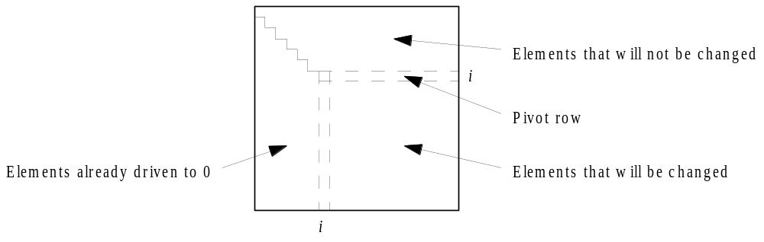
Iteration of Gaussian Elimination

Slide 33
Numerical Stability Issues
If pivot element close to zero, significant roundoff errors can result
Gaussian elimination with partial pivoting eliminates this problem
In step i we search rows i through n-1 for the row whose column i element has the largest absolute value
Swap (pivot) this row with row i

Slide 34
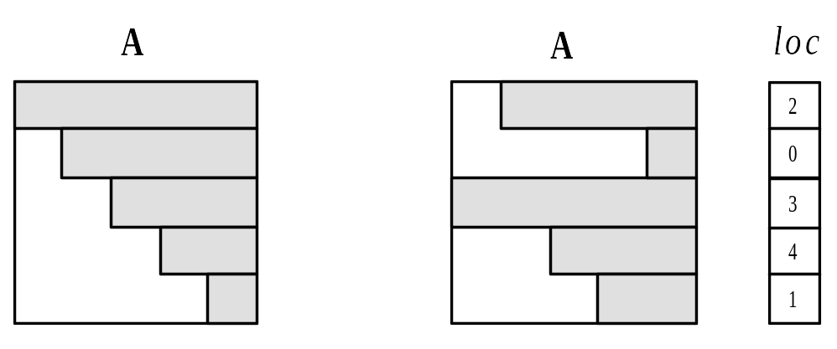
Implementing Partial Pivoting
Without partial pivoting
With partial pivoting

Slide 35
Row-oriented Parallel Algorithm
Associate primitive task with each row of A and corresponding elements of x and b
A kind of reduction needed to find the identity of the pivot row
Tournament: want to determine identity of row with largest value, rather than largest value itself
Could be done with two all-reductions
MPI provides a simpler, faster mechanism

Slide 36
MPI_MAXLOC, MPI_MINLOC
MPI provides reduction operators MPI_MAXLOC, MPI_MINLOC
Provide datatype representing a (value, index) pair

Slide 37
MPI (value,index) Datatypes
MPI_Datatype | Meaning
MPI_2INT | Two ints
MPI_DOUBLE_INT | A double followed by an int
MPI_FLOAT_INT | A float followed by an int
MPI_LONG_INT | A long followed by an int
MPI_LONG_DOUBLE_INT | A long double followed by an int
MPI_SHORT_INT | A short followed by an int

Slide 38
Example Use of MPI_MAXLOC
struct {
double value;
int index;
} local, global;
...
local.value = fabs(a[j][i]);
local.index = j;
...
MPI_Allreduce (&local, &global, 1,
MPI_DOUBLE_INT, MPI_MAXLOC,
MPI_COMM_WORLD);

Slide 39
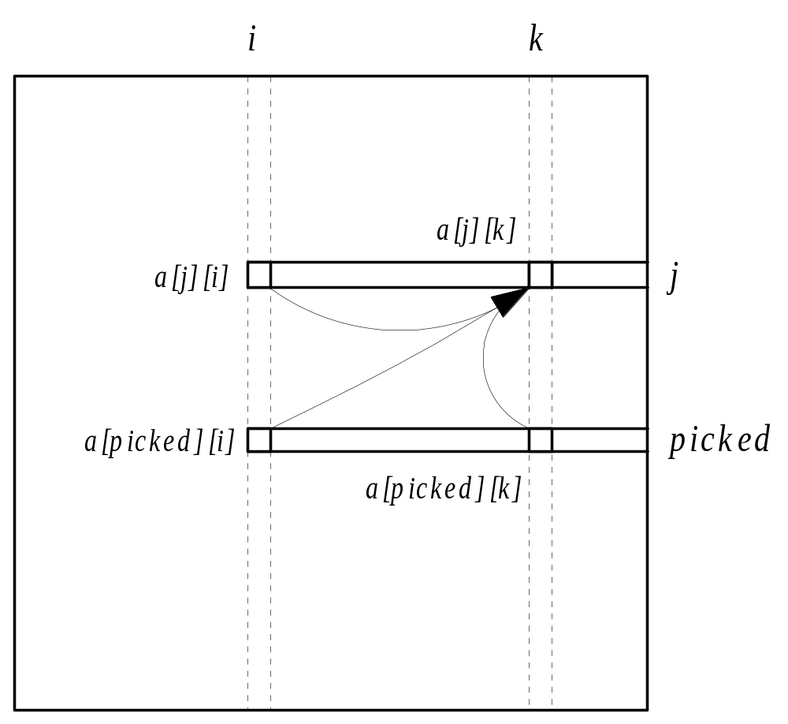
Second Communication per Iteration

Slide 40
Communication Complexity
Complexity of tournament: Θ(log p)
Complexity of broadcasting pivot row:
Θ(n log p)
A total of n - 1 iterations
Overall communication complexity:
Θ(n² log p)

Slide 41
Isoefficiency Analysis
Communication overhead: Θ(n² p log p)
Sequential algorithm has time complexity Θ(n³)
Isoefficiency relation
n³ ≥ Cn² p log p ⇒ n ≥ C p log p
This system has poor scalability

Slide 42
Column-oriented Algorithm
Associate a primitive task with each column of A and another primitive task for b
During iteration i task controlling column i determines pivot row and broadcasts its identity
During iteration i task controlling column i must also broadcast column i to other tasks
Agglomerate tasks in an interleaved fashion to balance workloads
Isoefficiency same as row-oriented algorithm

Slide 43
Comparison of Two Algorithms
Both algorithms evenly divide workload
Both algorithms do a broadcast each iteration
Difference: identification of pivot row
  Row-oriented algorithm does search in parallel but requires all-reduce step
  Column-oriented algorithm does search sequentially but requires no communication
Row-oriented superior when n relatively larger and p relatively smaller

Slide 44
Problems with These Algorithms
They break parallel execution into computation and communication phases
Processes not performing computations during the broadcast steps
Time spent doing broadcasts is large enough to ensure poor scalability

Slide 45
Pipelined, Row-Oriented Algorithm
Want to overlap communication time with computation time
We could do this if we knew in advance the row used to reduce all the other rows.
Let’s pivot columns instead of rows!
In iteration i we can use row i to reduce the other rows.

Slide 46
Communication Pattern
0
Reducing Using
Row 0
Row 0
3
1
2

Slide 47
Communication Pattern
0
Reducing Using
Row 0
3
Reducing Using
Row 0
1
Row 0
2

Slide 48
Communication Pattern
0
Reducing Using
Row 0
3
Reducing Using
Row 0
1
Row 0
2
Reducing Using
Row 0

Slide 49
Communication Pattern
0
Reducing Using
Row 0
3
Reducing Using
Row 0
1
Reducing Using
Row 0
2
Reducing Using
Row 0

Slide 50
Communication Pattern
0
3
Reducing Using
Row 0
1
Reducing Using
Row 0
2
Reducing Using
Row 0

Slide 51
Communication Pattern
0
3
Reducing Using
Row 0
1
Reducing Using
Row 1
Row 1
2
Reducing Using
Row 0

Slide 52
Communication Pattern
0
3
Reducing Using
Row 0
1
Reducing Using
Row 1
Row 1
2
Reducing Using
Row 1

Slide 53
Communication Pattern
0
Row 1
3
Reducing Using
Row 1
1
Reducing Using
Row 1
2
Reducing Using
Row 1

Slide 54
Communication Pattern
0
Reducing Using
Row 1
3
Reducing Using
Row 1
1
Reducing Using
Row 1
2
Reducing Using
Row 1

Slide 55
Analysis (1/2)
Total computation time: Θ(n³/p)
Total message transmission time: Θ(n²)
When n large enough, message transmission time completely overlapped by computation time
Message start-up not overlapped: Θ(n)
Parallel overhead: Θ(np)

Slide 56
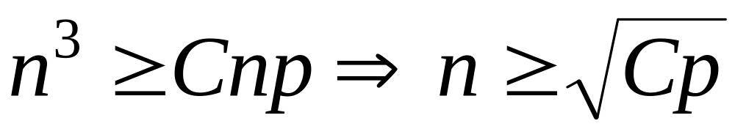

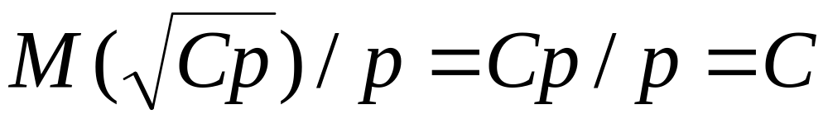
Analysis (2/2)
Isoefficiency relation:
Scalability function:
Parallel system is perfectly scalable

Slide 57
Sparse Systems
Gaussian elimination not well-suited for sparse systems
Coefficient matrix gradually fills with nonzero elements
Result
  Increases storage requirements
  Increases total operation count

Slide 58
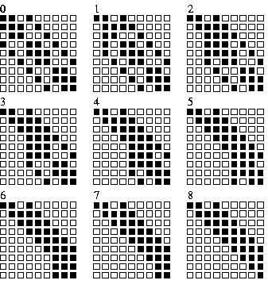
Example of “Fill”

Slide 59
Iterative Methods
Iterative method: algorithm that generates a series of approximations to solution’s value
Require less storage than direct methods
Since they avoid computations on zero elements, they can save a lot of computations

Slide 60
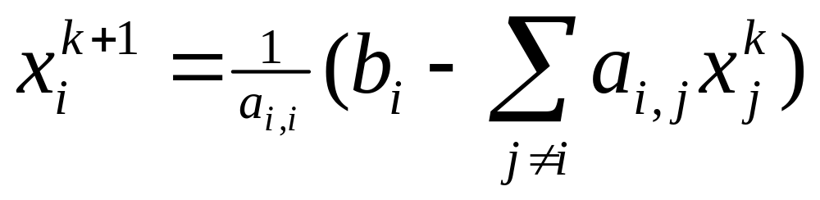

Jacobi Method
Values of elements of vector x at iteration k+1
depend upon values of vector x at iteration k
Gauss-Seidel method: Use latest version
available of x_{i}

Slide 61
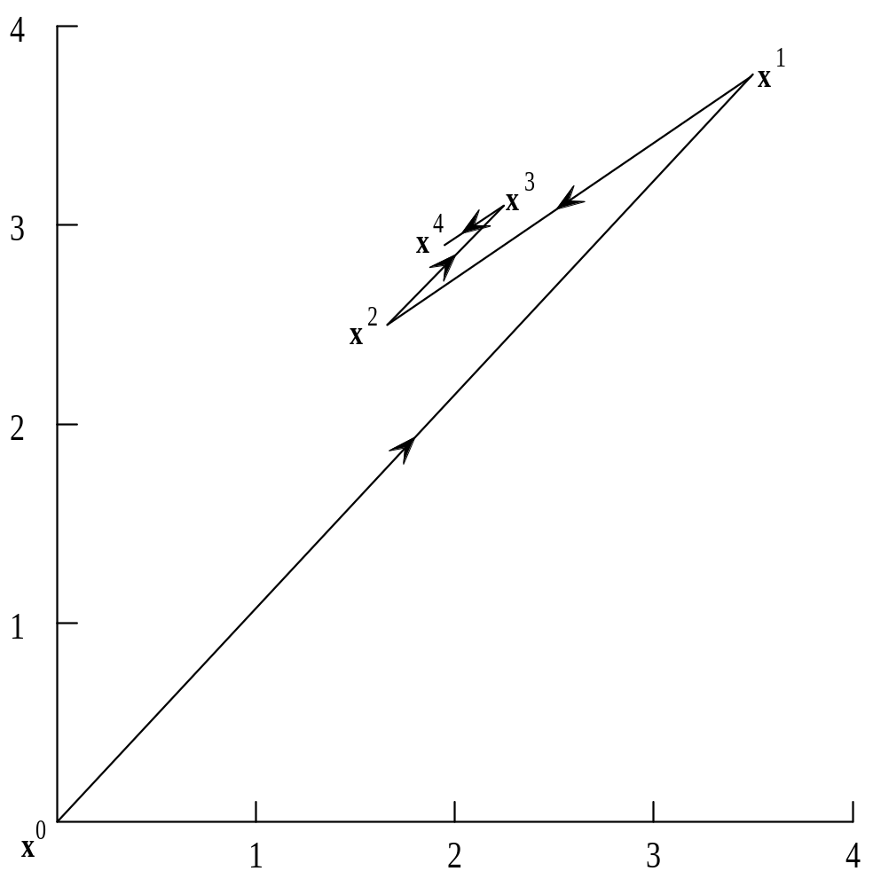
Jacobi Method Iterations

Slide 62
Rate of Convergence
Even when Jacobi method and Gauss-Seidel methods converge on solution, rate of convergence often too slow to make them practical
We will move on to an iterative method with much faster convergence

Slide 63
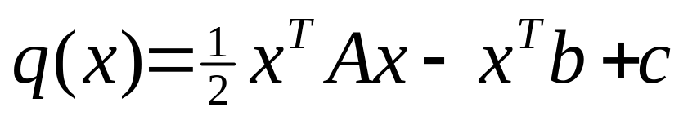
Conjugate Gradient Method
A is positive definite if for every nonzero vector x and its transpose x^{T}, the product x^{T}Ax > 0
If A is symmetric and positive definite, then the function
has a unique minimizer that is solution to Ax = b
Conjugate gradient is an iterative method that solves Ax = b by minimizing q(x)

Slide 64
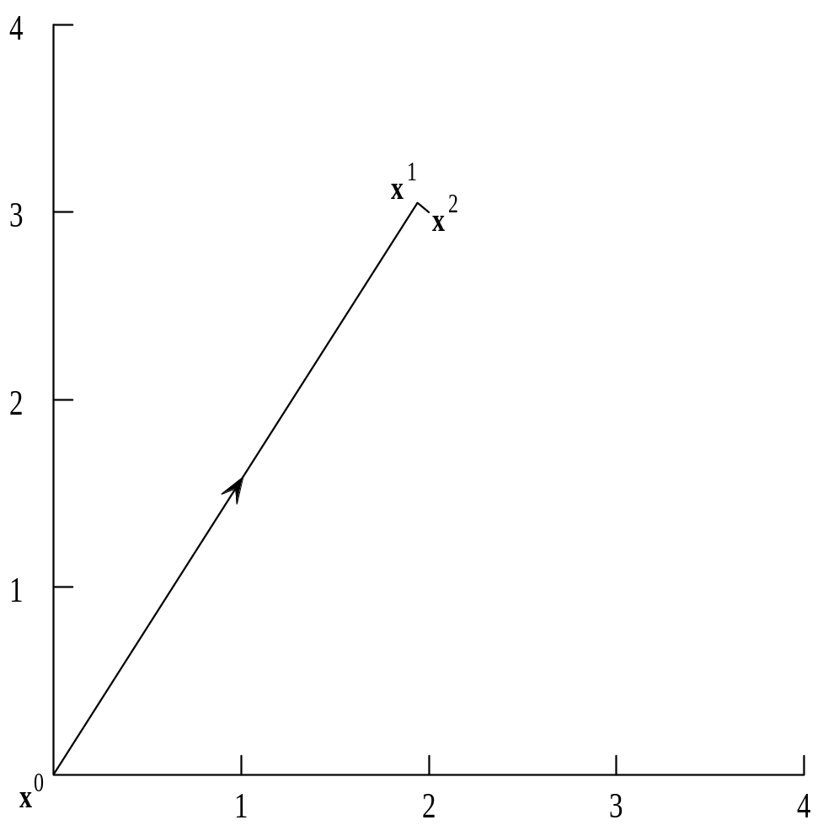
Conjugate Gradient Convergence
Finds value of
n-dimensional solution
in at most n iterations

Slide 65
Conjugate Gradient Computations
Matrix-vector multiplication
Inner product (dot product)
Matrix-vector multiplication has higher time complexity
Must modify previously developed algorithm to account for sparse matrices

Slide 66
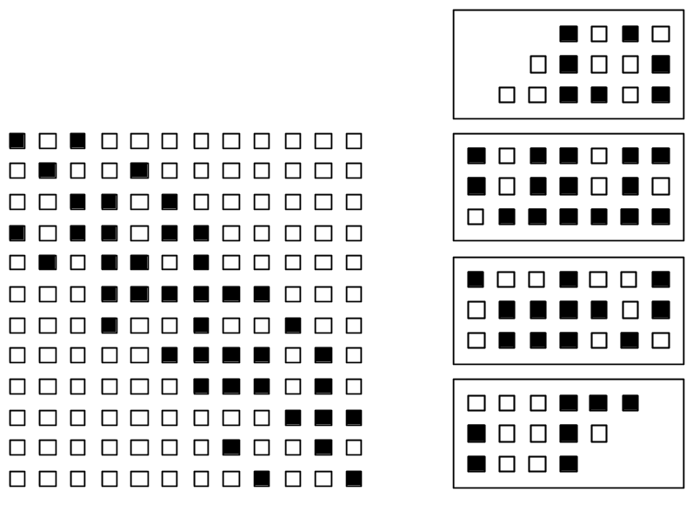
Rowwise Block Striped Decomposition of a Symmetrically Banded Matrix
Decomposition
Matrix

Slide 67
Representation of Vectors
Replicate vectors
  Need all-gather step after matrix-vector multiply
  Inner product has time complexity Θ(n)
Block decomposition of vectors
  Need all-gather step before matrix-vector multiply
  Inner product has time complexity
  Θ(n/p + log p)

Slide 68
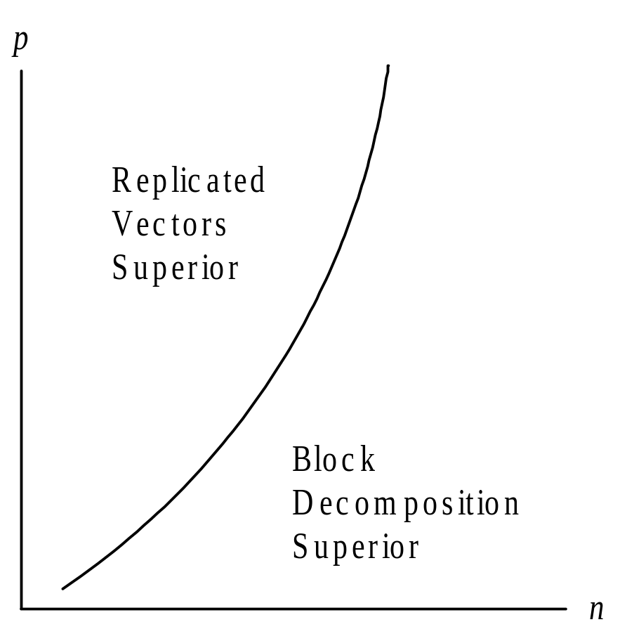
Comparison of Vector Decompositions

Slide 69
Summary (1/2)
Solving systems of linear equations
  Direct methods
  Iterative methods
Parallel designs for
  Back substitution
  Gaussian elimination
  Conjugate gradient method

Slide 70
Summary (2/2)
Superiority of one algorithm over another depends on size of problem, number of processors, characteristics of parallel computer
Overlapping communications with computations can be key to scalability

